Slide 1
Builder Design Pattern
Notes:
Builder pattern separates the construction of an object from its representation.

Slide 2
Why and what??
Builder pattern is used to create complex objects made from a bunch of other objects.
The creation of these parts is independent to the creation of the main object.
This pattern hides the creation of these parts from the client itself too, so that these parts are not dependent.
Only the builder knows the specifics and nobody else does.
It was introduced to solve problems of factory and abstract factory design patterns in which the object sometimes contains a lot of attributes.

Slide 3
Continued
Builder Pattern is perfectly suited for an immutable class when that class features a large number of attributes.
Builder approach is the ability to acquire an object in a single statement and state without the object in multiple states problem presented by using “Set” methods.
Notes:
By using setter the object is created over several calls it may be in an inconsistent state partway through its construction. This also requires a lot of extra effort to ensure thread safety.

Slide 4
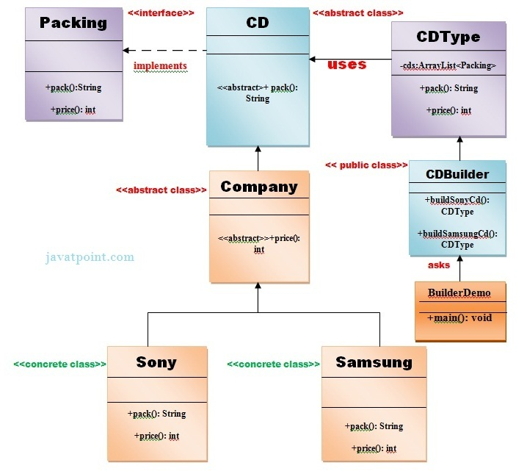

Slide 5
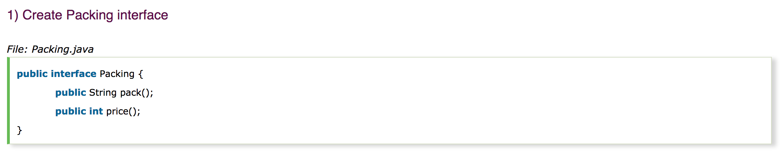

Slide 6
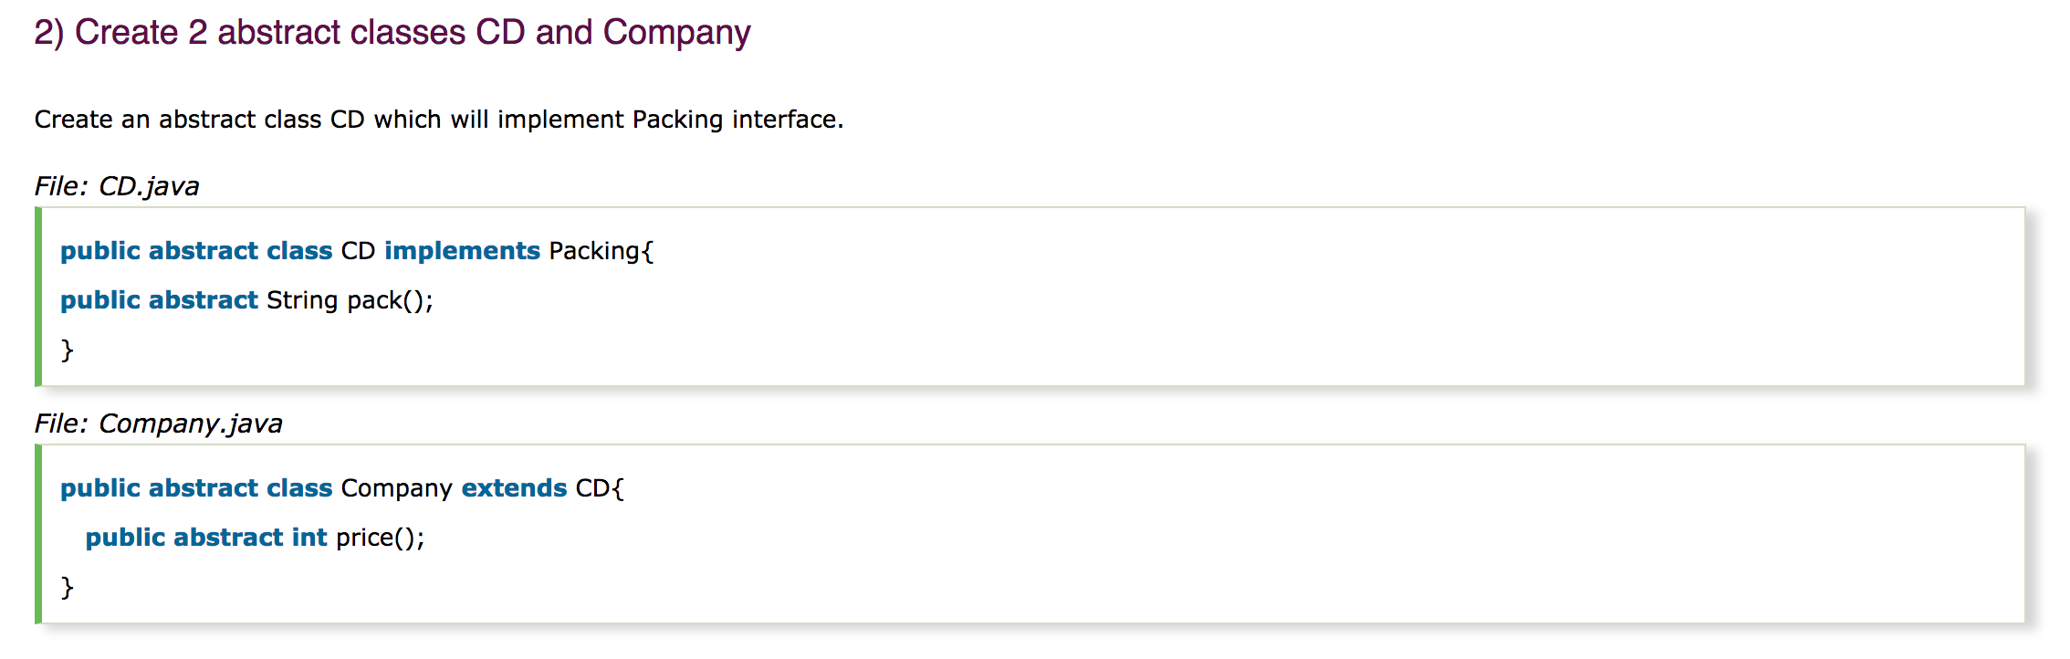

Slide 7


Slide 8
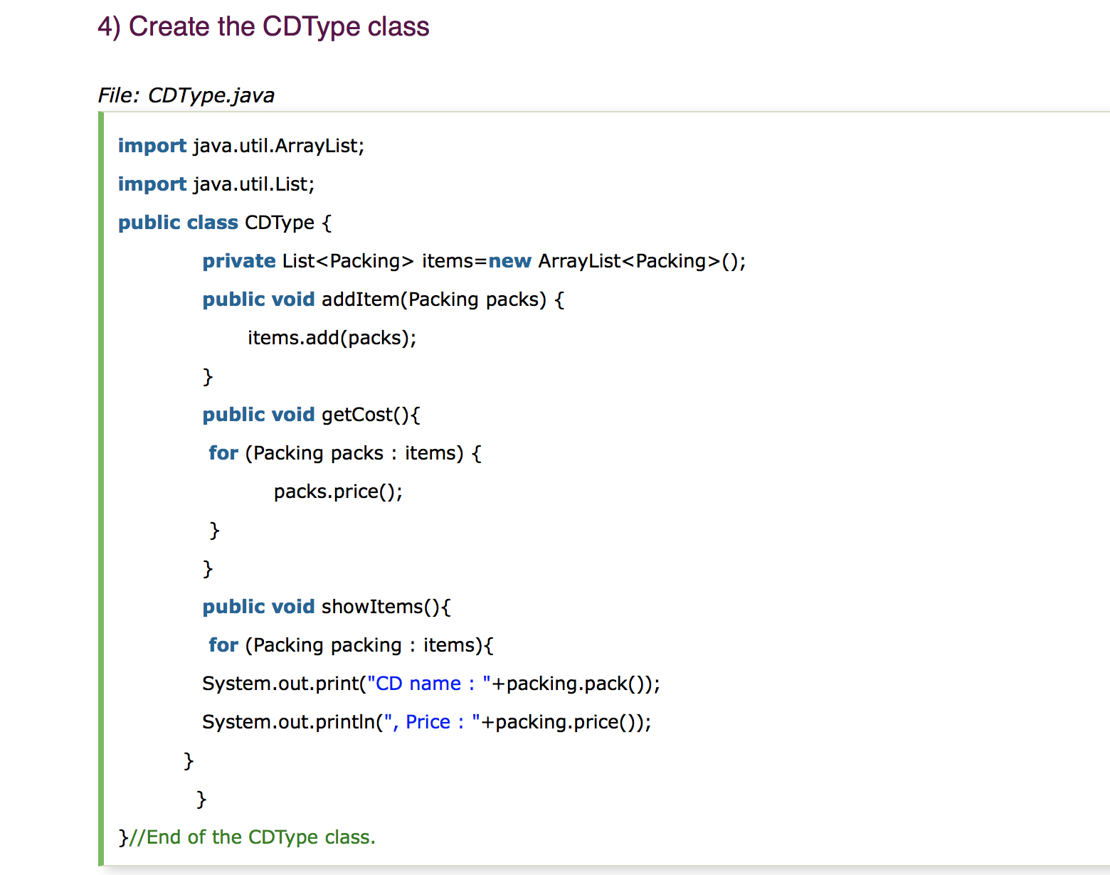

Slide 9
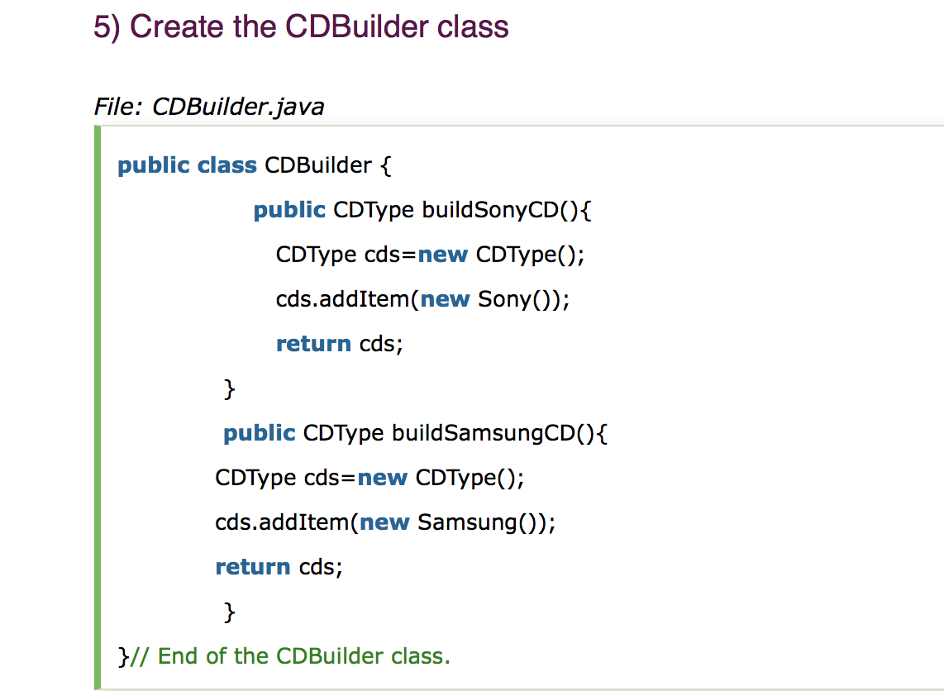

Slide 10
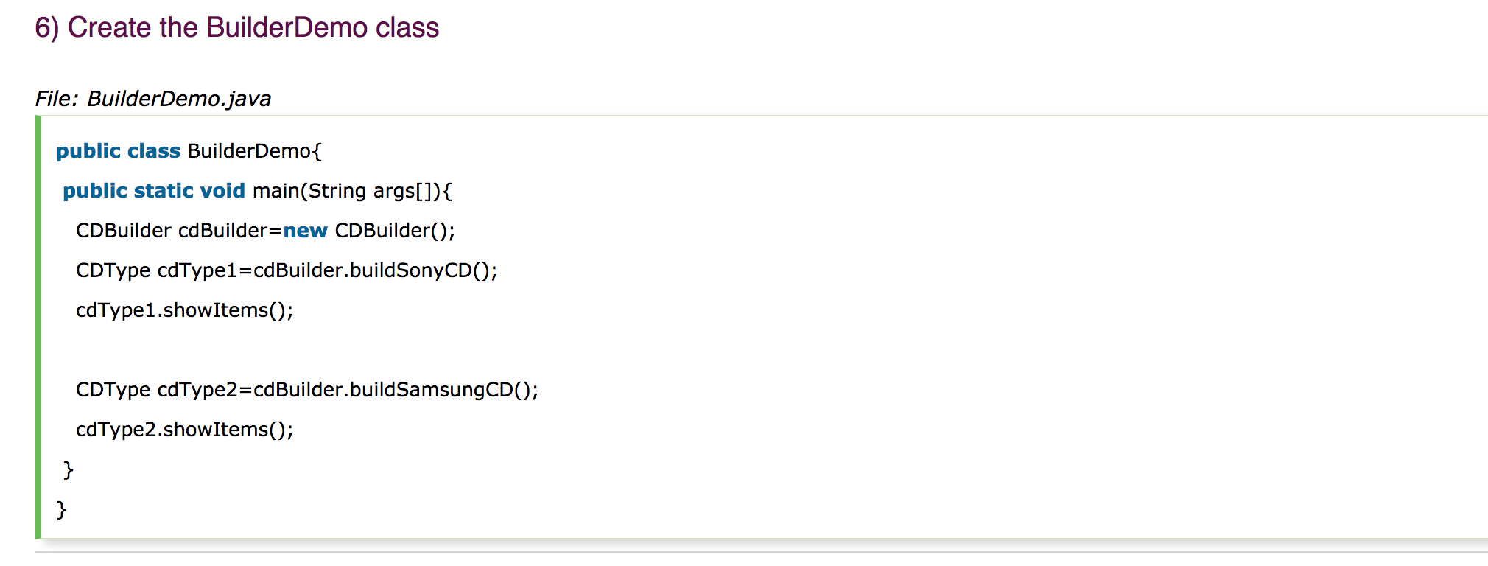

Slide 11
Advantages
Complex Object creation
When we are dealing with very complex object that have lots of properties that we would preferably only set once at object creation, doing this with regular constructors can become hard to read, because the constructor will have a long list of parameters.
By using setter the object is created over several calls it may be in an inconsistent state partway through its construction. This also requires a lot of extra effort to ensure thread safety.
Notes:
https://stackoverflow.com/questions/6927292/javaworld-on-oo-getters-setters-vs-builder

Slide 12
2. Extensible API
When we only publish a multi-parameter constructor for our class and later decide to add a new (optional) property (say in a later version of our software) we have to create a second constructor that is identical to the first one, but takes one more parameter. Otherwise - we have to just add it to the existing constructor - you would break compatibility with existing code.
With a builder, you simply add a new method for the new property, with all existing code still being compatible.

Slide 13
3. Immutability
For parallel execution of multiple threads it is best to use objects that cannot be modified after they have been created (immutable objects), because these cannot cause problems with concurrent updates from multiple threads. This is why setters are not an option.
Now, if you want to avoid the problems of the multi-parameter public constructors, that leaves builders as a very convenient alternative.

Slide 14
Caution
Developers may forget to add support for a new attribute to the builder when they add that attribute to the main class. To try to help with this, we can nest the builders inside the class that they build so that it's more obvious to the developer that there is a relevant builder that needs to be similarly updated.
Code Duplication as builder needs to copy all the fields from the original class.

Slide 15
Thank you

